Slide 1
Chi-Square Tests
Association, Homogeneity, and Goodness of Fit

Slide 2
Types of Chi-Square Tests
Independence / Association: Are two categorical variables related in one sample?
Homogeneity: Do multiple groups have the same distribution of a categorical variable?
Goodness of Fit: Does one categorical variable follow a claimed distribution?

Slide 3
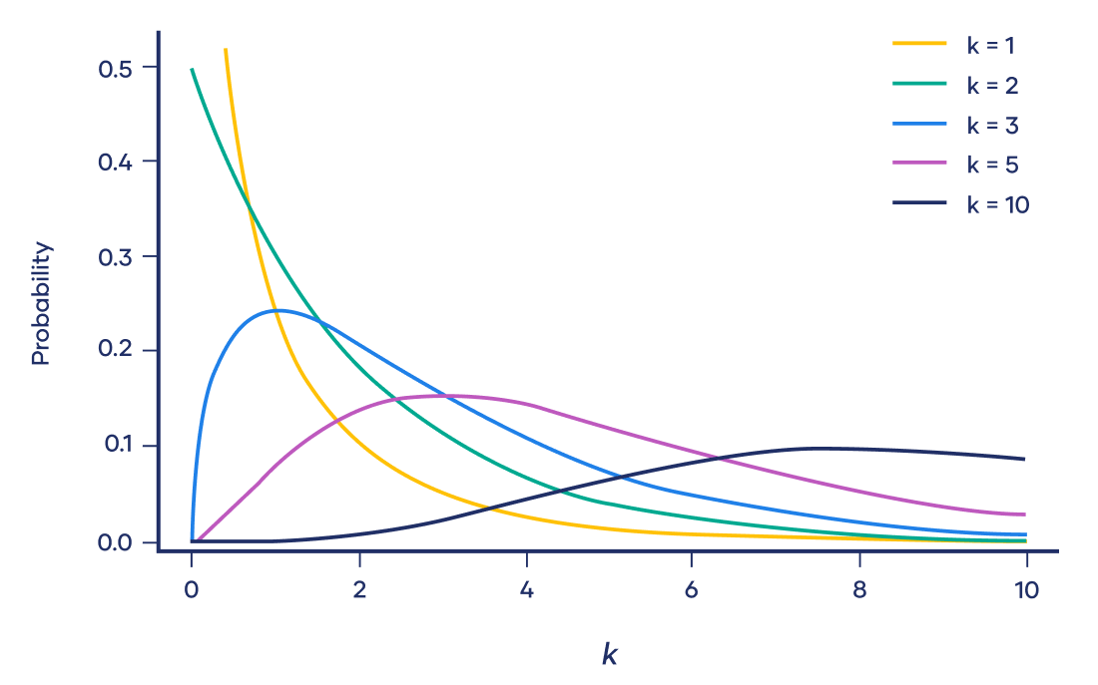
Assumptions
Variables are categorical
Data are in counts of cases, not percentages, means, or measurements
Observations are independent
Expected counts should be sufficiently large, typically at least 5 as a rule of thumb
Each count should contribute to only one cell
Notes:
Ideally all expected counts are at least 5, or at least no more than 20% are below 5 and none are below 1

Slide 4
Test of Association
What it does
Tests whether two categorical variables are related.
When to use it
Use this test when:
you have one sample
each individual is measured on two categorical variables
you want to know whether the variables are associated or independent
Example
A researcher surveys 200 college students and records:
class year: freshman, sophomore, junior, senior
car ownership: yes or no
Question: Is car ownership associated with class year?
Conditions
variables are categorical
data are counts of individuals
observations are independent
expected counts are sufficiently large, usually at least 5

Slide 5
Test of Association…
Is pet preference associated with gender?
H0: There is no association / variables are independent
HA: There is an association / variables are not independent
 | Dogs | Cats
Males | 26 | 24
Females | 29 | 21

Slide 6
Observed Counts and Totals
 | Dogs | Cats
Males | 26 | 24
Females | 29 | 21
 | Dogs | Cats | Totals
Males | 26 | 24 | 50
Females | 29 | 21 | 50
Totals | 55 | 45 | 100

Slide 7
Expected Counts
Expected counts: What would be expected if gender and pet preference are independent.
Expected counts = (Row total * Column total) / Grand Total
Observed | Dogs | Cats | Totals
Males | 26 | 24 | 50
Females | 29 | 21 | 50
Totals | 55 | 45 | 100
Expected | Dogs | Cats
Males | 27.5 | 22.5
Females | 27.5 | 22.5
Notes:
Male Dogs = (55 * 50) / 100 = 27.5

Slide 8

Calculating The Chi-Square Statistic
For each cell:
Calculate observed minus expected
Square the differences
Divide by expected
Sum up all the values
Chi-Square Test Statistic= 0.364
df = (rows - 1) * (columns -1) = 1
Critical value at alpha=5% with df=1 = 3.841
Reject H0 if statistic > critical value
Conclusion: Fail to reject the null. There is not sufficient evidence of an association between gender and pet preference.
 | Dogs | Cats
Male | 0.082 | 0.1
Female | 0.082 | 0.1

Slide 9
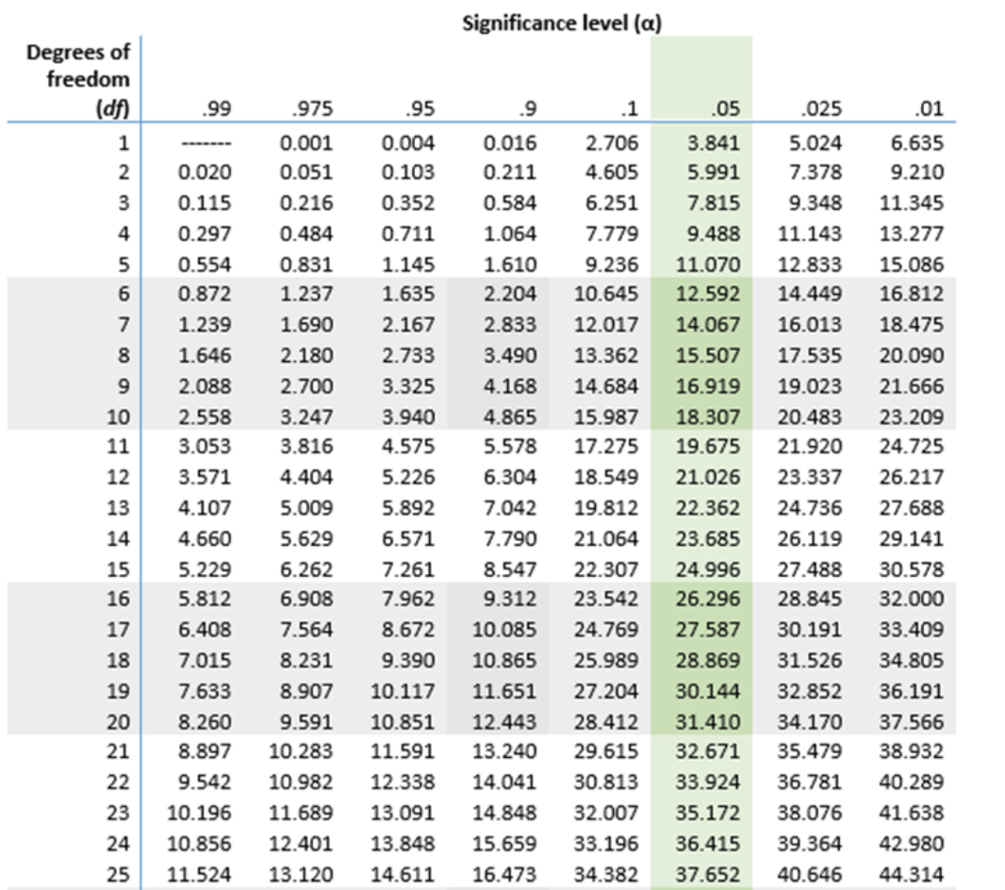
Chi Square Table

Slide 10
Test of Homogeneity
What it does
Tests whether different groups have the same distribution of a categorical variable.
When to use it
Use this test when:
you have separate samples from two or more groups
you measure one categorical variable
you want to compare the distribution of that variable across groups
Example
A researcher samples students from three colleges and records their preferred class format:
in person
hybrid
online
Question: Do the three colleges have the same distribution of class format preferences?
Conditions
data are counts in categories
samples/groups are independent
observations within each group are independent
expected counts are sufficiently large, usually at least 5

Slide 11
2) Test of Homogeneity
Do men and women have different fruit preference distributions?
H0: There is no difference in the fruit preferences of men and women
HA: There is a difference in the fruit preferences of men and women
 | Apples | Bananas | Cherries | Total
Male | 17 | 24 | 9 | 50
Female | 19 | 14 | 17 | 50
Total | 36 | 38 | 26 | 100

Slide 12
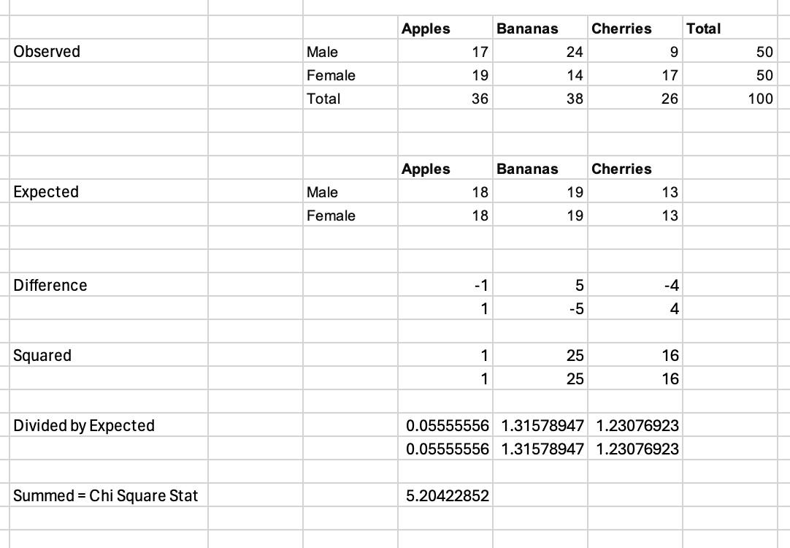
Calculating The Chi-Square Statistic
For each cell:
Calculate expected ((row total x column total) / total)
Calculate observed minus expected
Square the differences
Divide by expected
Sum up all the values
Chi- Square Test Statistic: 5.204
df = (rows - 1) * (columns -1): 2
Critical value at alpha=5% with and degrees of freedom =2 : 5.991
Reject the null if Stat > CV
Conclusion: Fail to reject the null. There is not sufficient evidence that fruit preference distributions differ between men and women.

Slide 13
Chi Square Table

Slide 14
Test of Goodness of Fit
What it does
Tests whether the distribution of one categorical variable matches a claimed or expected distribution.
When to use it
Use this test when:
you have one categorical variable
you have a claimed, theoretical, or expected distribution
you want to compare observed counts to expected counts
Example
A candy company claims its candies are:
30% red
20% blue
20% green
15% yellow
15% orange
Question: Does a sample of candies match this claimed color distribution?
Conditions
data are counts in categories
observations are independent
expected counts are sufficiently large, usually at least 5

Slide 15
3) Test of Goodness of Fit
H0: Observed frequencies follow expected / theoretical distribution
HA: Observed frequencies do not follow expected / theoretical distribution
Dice Side | Observed | Expected
1 | 17 | 100/6 = 16.6
2 | 14 | 16.6
3 | 15 | 16.6
4 | 17 | 16.6
5 | 19 | 16.6
6 | 18 | 16.6

Slide 16
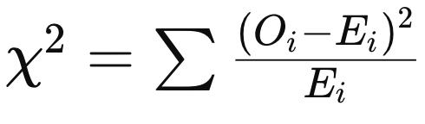
Dice Side | Observed | Expected | Difference | Diff Squared | (O - E)^2 / E
1 | 17 | 16.6 | 0.4 | 0.16 | 0.00963855
2 | 14 | 16.6 | -2.6 | 6.76 | 0.40722892
3 | 15 | 16.6 | -1.6 | 2.56 | 0.15421687
4 | 17 | 16.6 | 0.4 | 0.16 | 0.00963855
5 | 19 | 16.6 | 2.4 | 5.76 | 0.34698795
6 | 18 | 16.6 | 1.4 | 1.96 | 0.11807229
Summed DS/E = Chi Square Statistic = 1.0458
df =k -1 = 6 -1 = 5
Compare to Chi Square Critical Value for given alpha (5%) and degrees of freedom = 11.07
Reject the null that the observed frequencies follow the expected frequencies if Stat > CV
Conclusion: Fail to reject the null. There is not sufficient evidence that the dice is unfair.
Notes:
Df = degrees of freedom = categories - parameters estimated in obtaining expected frequencies - 1

Slide 17
Dice Side | Observed | Expected | Difference | Diff Squared | (O - E)^2 / E
1 | 24 | 16.6 | 7.4 | 54.76 | 3.298795181
2 | 19 | 16.6 | 2.4 | 5.76 | 0.346987952
3 | 6 | 16.6 | -10.6 | 112.36 | 6.768674699
4 | 25 | 16.6 | 8.4 | 70.56 | 4.25060241
5 | 3 | 16.6 | -13.6 | 184.96 | 11.14216867
6 | 23 | 16.6 | 6.4 | 40.96 | 2.46746988
Summed DS/E = Chi Square Statistic = 28.27
Compare to Chi Square Critical Value for given alpha and degrees of freedom = 11.07
df = number of categories - 1* = 6 - 1 - 5
Reject the null that the observed frequencies follow the expected frequencies if Stat > CV
Conclusion: Reject the null. There is sufficient evidence that the die’s outcome distribution is not uniform.
Notes:
df = categories - parameters estimated in obtaining expected frequencies - 1

